Slide 1
Today’s Class
CS F212 Database Systems
E R Model

Slide 2
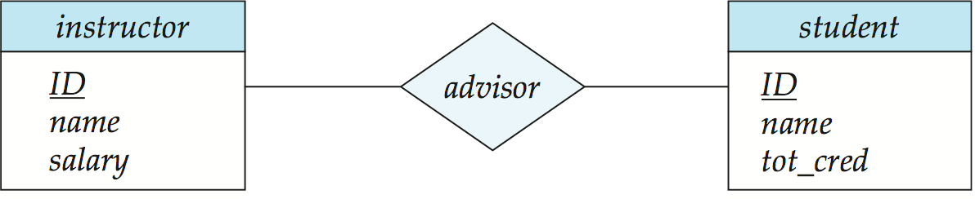
E-R Diagrams
Rectangles represent entity sets.
Diamonds represent relationship sets.
Attributes listed inside entity rectangle
Underline indicates primary key attributes

Slide 3
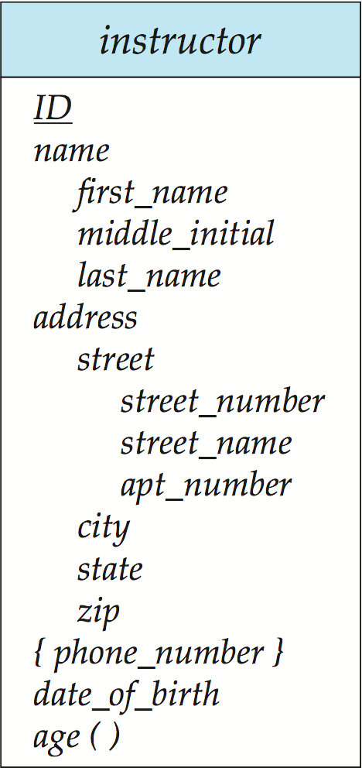
Entity With Composite, Multivalued, and Derived Attributes

Slide 4
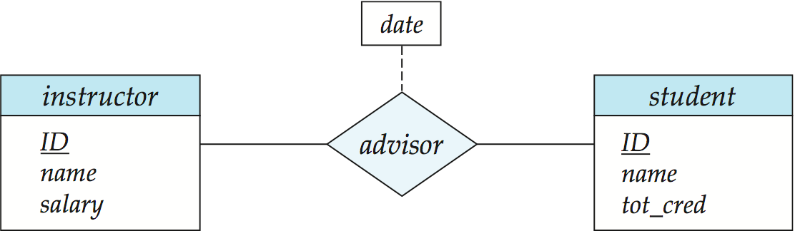
Relationship Sets with Attributes

Slide 5
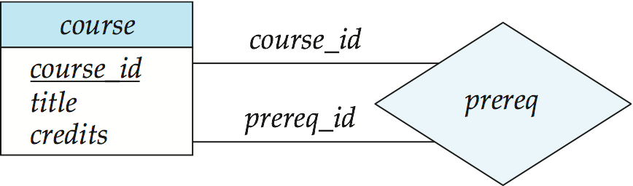
Roles
Entity sets of a relationship need not be distinct
Each occurrence of an entity set plays a “role” in the relationship
The labels “course_id” and “prereq_id” are called roles.

Slide 6
Cardinality Constraints
We express cardinality constraints by drawing either a directed line (→), signifying “one,” or an undirected line (—), signifying “many,” between the relationship set and the entity set.
One-to-one relationship:
A student is associated with at most one instructor via the relationship advisor
A student is associated with at most one department via stud_dept

Slide 7
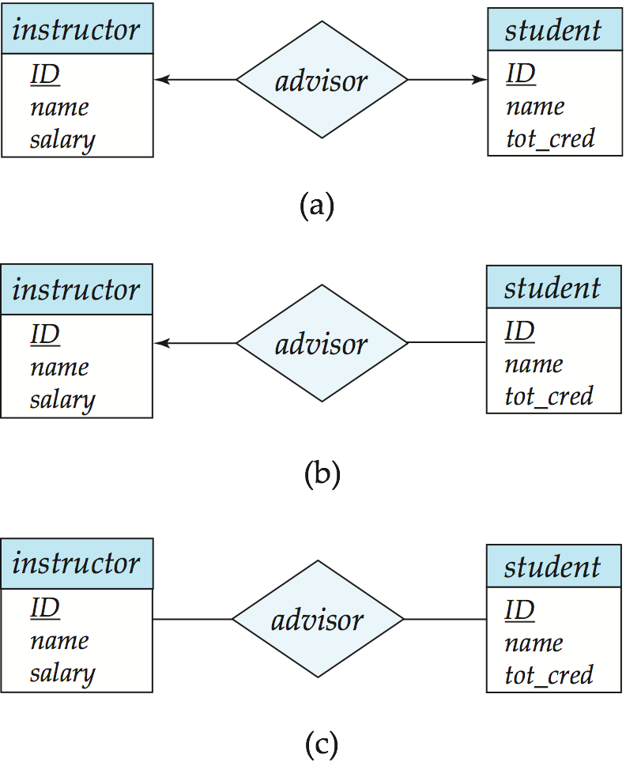
One-to-One Relationship
one-to-one relationship between an instructor and a student
an instructor is associated with at most one student via advisor
and a student is associated with at most one instructor via advisor

Slide 8
One-to-Many Relationship
one-to-many relationship between an instructor and a student
an instructor is associated with several (including 0) students via advisor
a student is associated with at most one instructor via advisor,

Slide 9
Many-to-One Relationships
In a many-to-one relationship between an instructor and a student,
an instructor is associated with at most one student via advisor,
and a student is associated with several (including 0) instructors via advisor

Slide 10

Many-to-Many Relationship
An instructor is associated with several (possibly 0) students via advisor
A student is associated with several (possibly 0) instructors via advisor

Slide 11
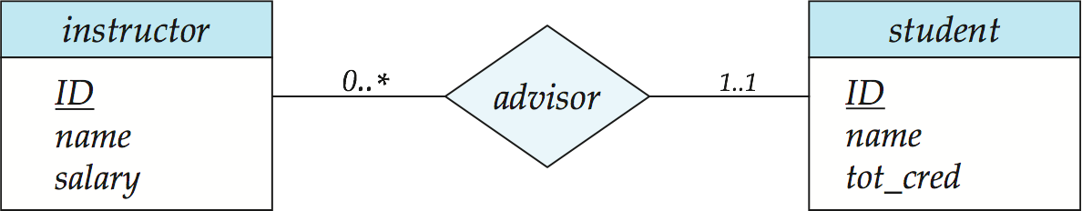
Alternative Notation for Cardinality Limits
Cardinality limits can also express participation constraints

Slide 12
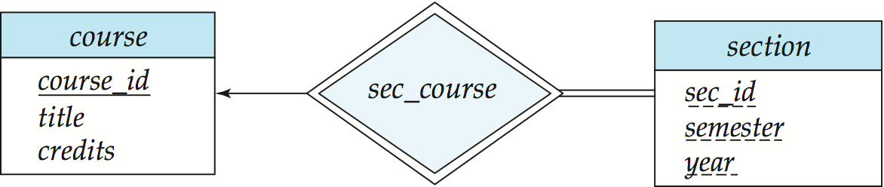
Participation of an Entity Set in a Relationship Set
Total participation (indicated by double line): every entity in the entity set participates in at least one relationship in the relationship set
E.g., participation of section in sec_course is total
every section must have an associated course
Partial participation: some entities may not participate in any relationship in the relationship set
Example: participation of instructor in advisor is partial

Slide 13
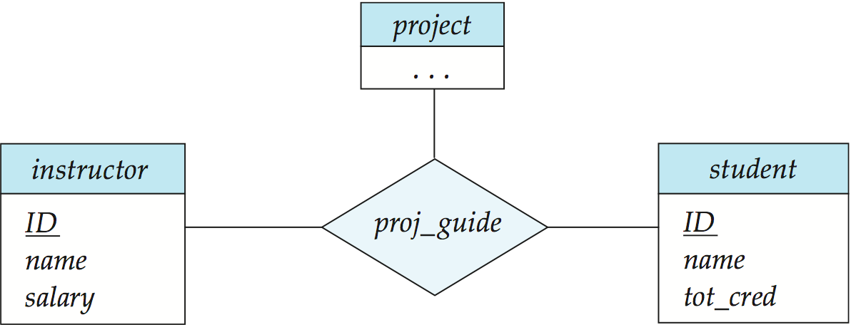
E-R Diagram with a Ternary Relationship

Slide 14
Cardinality Constraints on Ternary Relationship
We allow at most one arrow out of a ternary (or greater degree) relationship to indicate a cardinality constraint
E.g., an arrow from proj_guide to instructor indicates each student has at most one guide for a project
If there is more than one arrow, there are two ways of defining the meaning.
E.g., a ternary relationship R between A, B and C with arrows to B and C could mean
1. each A entity is associated with a unique entity from B and C or
2. each pair of entities from (A, B) is associated with a unique C entity, and each pair (A, C) is associated with a unique B
Each alternative has been used in different formalisms
To avoid confusion we outlaw more than one arrow

Slide 15
Weak Entity Sets
An entity set that does not have a primary key is referred to as a weak entity set.
The existence of a weak entity set depends on the existence of a identifying entity set
it must relate to the identifying entity set via a total, one-to-many relationship set from the identifying to the weak entity set
Identifying relationship depicted using a double diamond
The discriminator (or partial key) of a weak entity set is the set of attributes that distinguishes among all the entities of a weak entity set.
The primary key of a weak entity set is formed by the primary key of the strong entity set on which the weak entity set is existence dependent, plus the weak entity set’s discriminator.

Slide 16
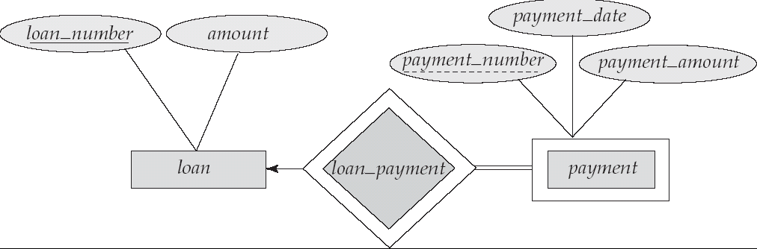
Weak Entity Sets
We depict a weak entity set by double rectangles.
We underline the discriminator of a weak entity set with a dashed line.
payment_number – discriminator of the payment entity set
Primary key for payment – (loan_number, payment_number)

Slide 17
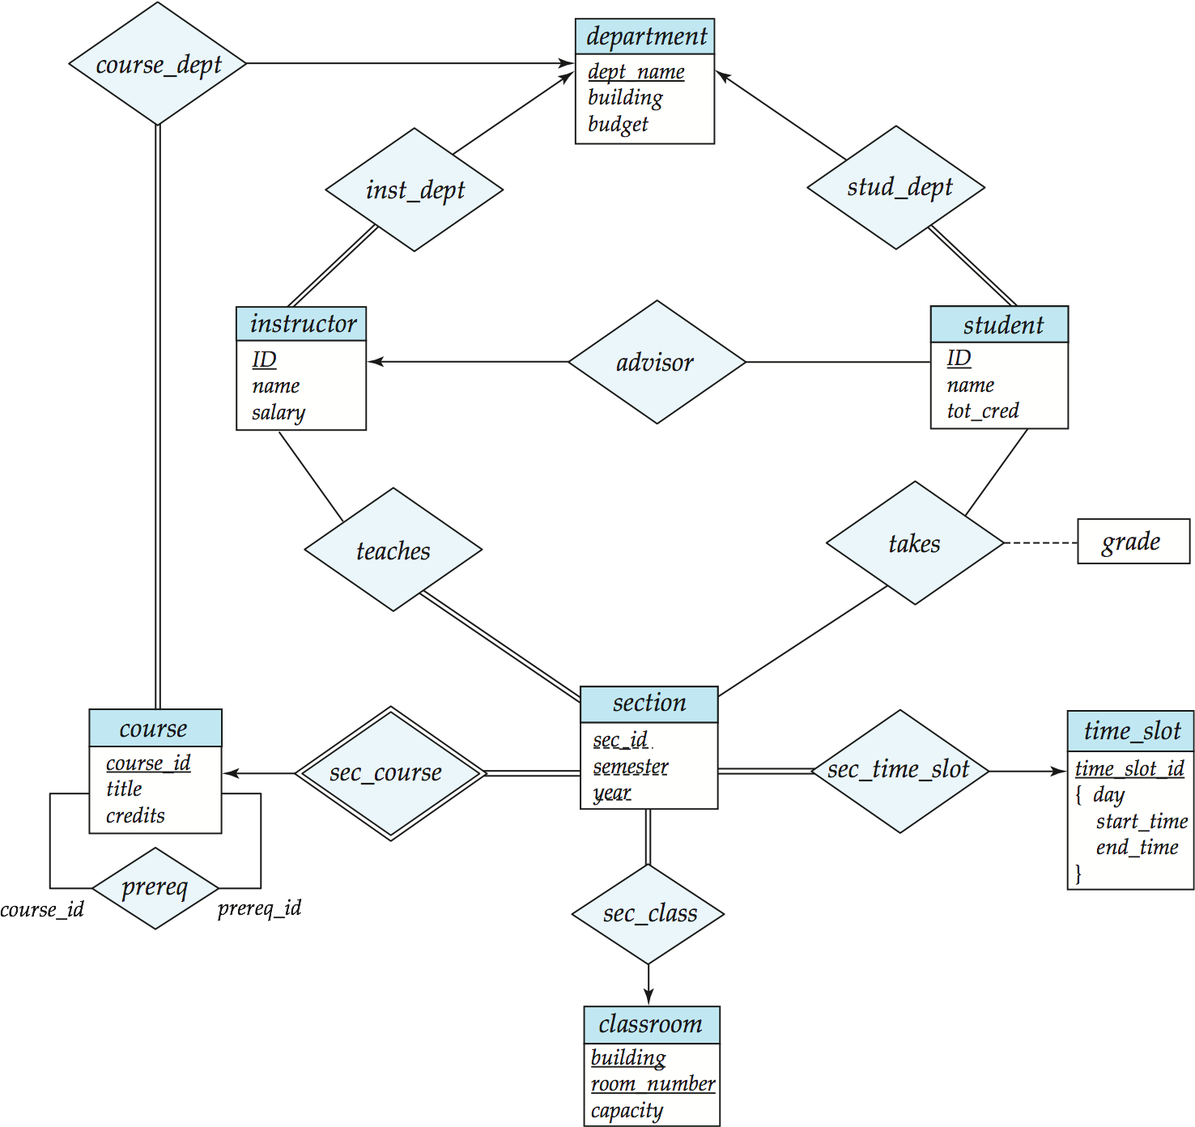
E-R Diagram for a University Enterprise

Slide 18
Extended ER Features

Slide 19
Extended E-R Features: Specialization
Top-down design process; we designate subgroupings within an entity set that are distinctive from other entities in the set.
These subgroupings become lower-level entity sets that have attributes or participate in relationships that do not apply to the higher-level entity set.
Depicted by a triangle component labeled ISA (E.g., instructor “is a” person).
Attribute inheritance – a lower-level entity set inherits all the attributes and relationship participation of the higher-level entity set to which it is linked.

Slide 20
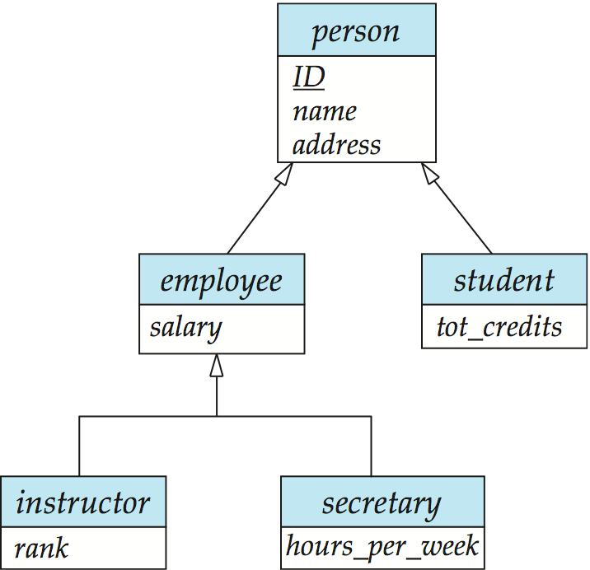
Specialization Example

Slide 21
Extended ER Features: Generalization
A bottom-up design process – combine a number of entity sets that share the same features into a higher-level entity set.
Specialization and generalization are simple inversions of each other; they are represented in an E-R diagram in the same way.
The terms specialization and generalization are used interchangeably.

Slide 22
Specialization and Generalization (Cont.)
Can have multiple specializations of an entity set based on different features.
E.g., permanent_employee vs. temporary_employee, in addition to instructor vs. secretary
Each particular employee would be
a member of one of permanent_employee or temporary_employee,
and also a member of one of instructor, secretary
The ISA relationship also referred to as superclass - subclass relationship

Slide 23
Design Constraints on a Specialization/Generalization
Constraint on which entities can be members of a given lower-level entity set.
condition-defined
Example: all customers over 65 years are members of senior-citizen entity set; senior-citizen ISA person.
user-defined
Constraint on whether or not entities may belong to more than one lower-level entity set within a single generalization.
Disjoint
an entity can belong to only one lower-level entity set
Noted in E-R diagram by having multiple lower-level entity sets link to the same triangle
Overlapping
an entity can belong to more than one lower-level entity set

Slide 24
Design Constraints on a Specialization/Generalization (Cont.)
Completeness constraint -- specifies whether or not an entity in the higher-level entity set must belong to at least one of the lower-level entity sets within a generalization.
total: an entity must belong to one of the lower-level entity sets
partial: an entity need not belong to one of the lower-level entity sets (default)

Slide 25
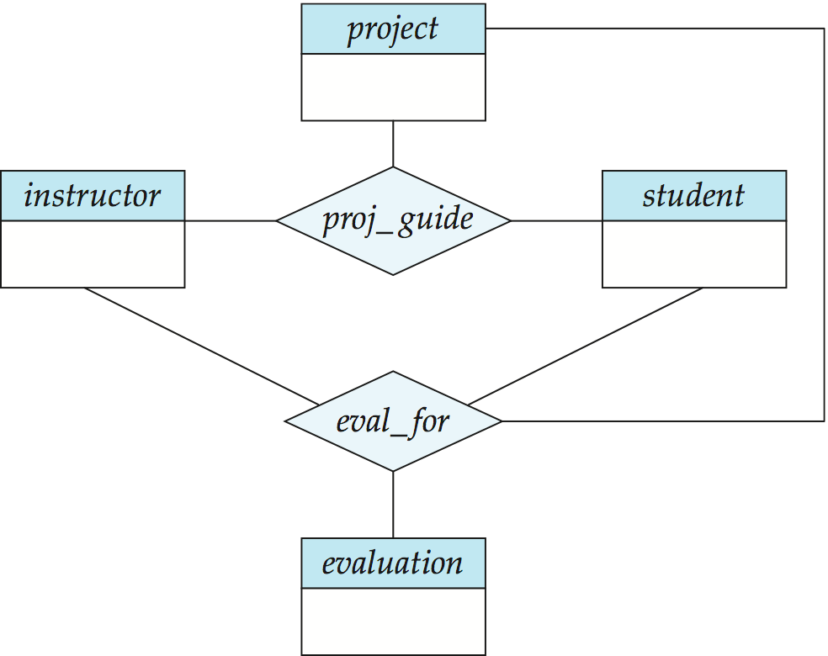
Aggregation
Consider the ternary relationship proj_guide, which we saw earlier
Suppose we want to record evaluations of a student by a guide on a project

Slide 26
Aggregation (Cont.)
Relationship sets eval_for and proj_guide represent overlapping information
Every eval_for relationship corresponds to a proj_guide relationship
However, some proj_guide relationships may not correspond to any eval_for relationships
So we can’t discard the proj_guide relationship
Eliminate this redundancy via aggregation
Treat relationship as an abstract entity
Allows relationships between relationships
Abstraction of relationship into new entity

Slide 27
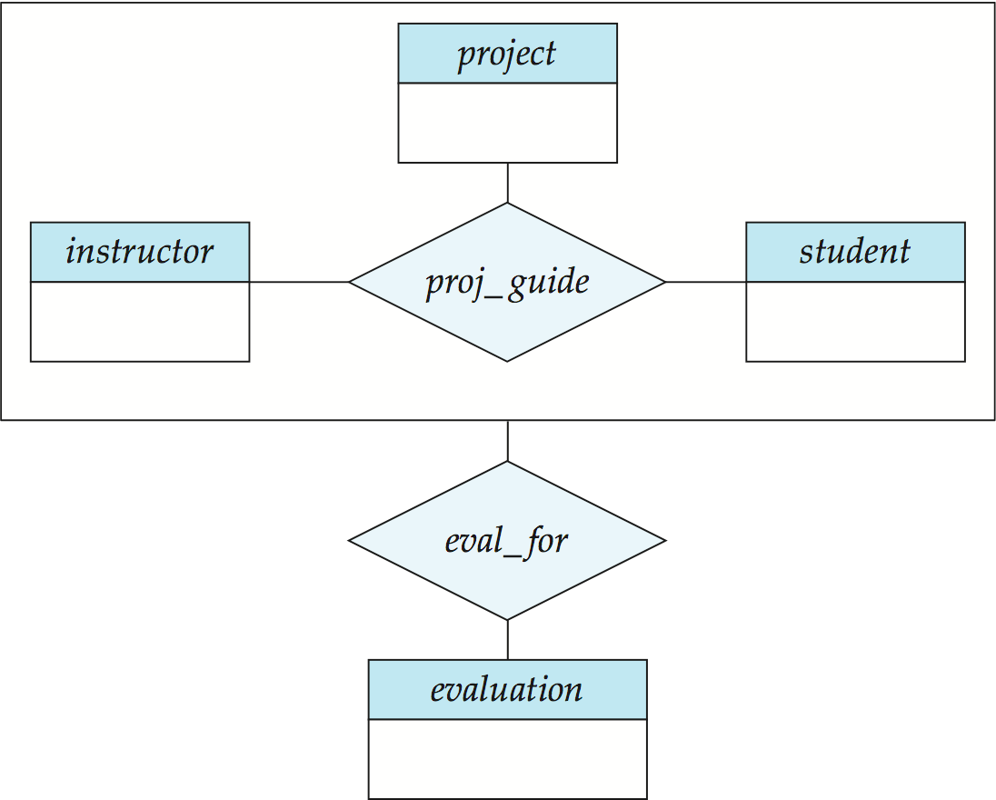
Aggregation (Cont.)
Without introducing redundancy, the following diagram represents:
A student is guided by a particular instructor on a particular project
A student, instructor, project combination may have an associated evaluation
Notes:
27

Slide 28
Aggregation
Relationship sets works_on and manages represent overlapping information
Every manages relationship corresponds to a works_on relationship
However, some works_on relationships may not correspond to any manages relationships
So we can’t discard the works_on relationship
Eliminate this redundancy via aggregation
Treat relationship as an abstract entity
Allows relationships between relationships
Abstraction of relationship into new entity
Without introducing redundancy, the following diagram represents:
An employee works on a particular job at a particular branch
An employee, branch, job combination may have an associated manager

Slide 29
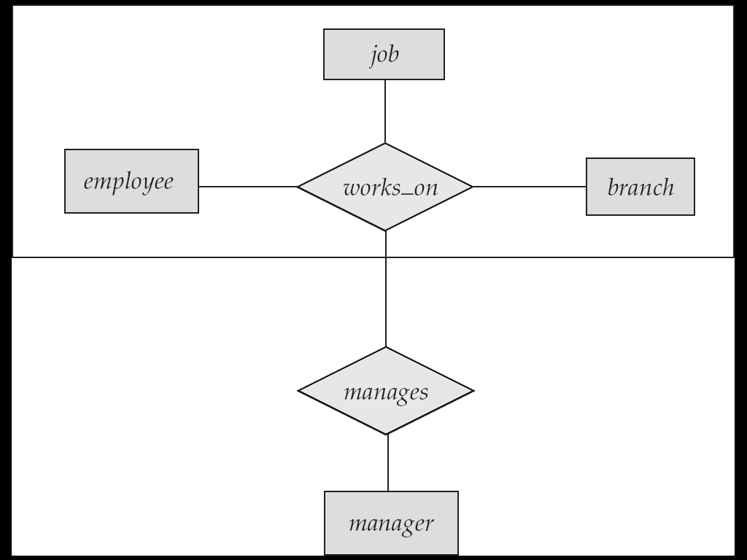
E-R Diagram With Aggregation

Slide 30
Aggregation
name
ssn
lot
Employees
Used when we have to model a relationship involving (entity sets and) a relationship set.
Aggregation allows us to treat a relationship set as an entity set for purposes of participation in (other) relationships.
Monitors
until
started_on
since
dname
pid
pbudget
did
budget
Projects
Sponsors
Departments
Aggregation vs. ternary relationship:
Monitors is a distinct relationship,
with a descriptive attribute.
Also, can say that each sponsorship
is monitored by at most one employee.
Notes:
2

Slide 31
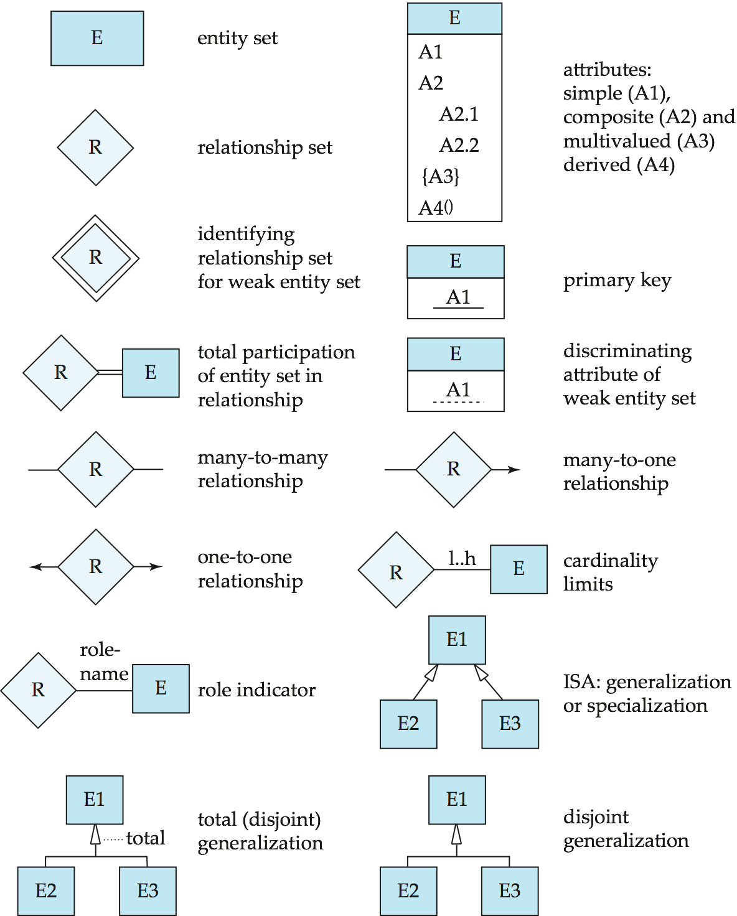
Summary of Symbols Used in E-R Notation

Slide 32
Symbols Used in E-R Notation (Cont.)

Slide 33
RELATIONSHIPS (Cont…)
Example: A library database contains a listing of authors that have written books on various subjects (one author per book). It also contains information about libraries that carry books on various subjects.
Entity sets: authors, subjects, books, libraries
Relationship sets: wrote, carry, indexed

Slide 34
RELATIONSHIPS (Cont…)
Subject
matter
title
isbn
SS#
authors
wrote
books
index
subject
name
carry
address
libraries

Slide 35
RELATIONSHIPS (Cont…)
Subject
matter
title
isbn
SS#
authors
wrote
books
index
subject
name
quantity
carry
address
libraries

Slide 36
E-R Design Decisions
The use of an attribute or entity set to represent an object.
Whether a real-world concept is best expressed by an entity set or a relationship set.
The use of a ternary relationship versus a pair of binary relationships.
The use of a strong or weak entity set.
The use of specialization/generalization – contributes to modularity in the design.
The use of aggregation – can treat the aggregate entity set as a single unit without concern for the details of its internal structure.

Slide 37
Conceptual Design Using the ER Model
Design choices:
Should a concept be modeled as an entity or an attribute?
Should a concept be modeled as an entity or a relationship?
Identifying relationships: Binary or ternary? Aggregation?
Constraints in the ER Model:
A lot of data semantics can (and should) be captured.
But some constraints cannot be captured in ER diagrams.
Notes:
3

Slide 38
Design Techniques
Avoid redundancy.
Limit the use of weak entity sets.
Don’t use an entity set when an attribute will do.

Slide 39
Valid E/R Diagrams
An E/R diagram is valid if and only if:
It is syntactically correct (e.g. specifies all key constraints,…)
It specifies the entity types, relationship types, attribute types, and subtype relationships necessary to satisfy all information requirements.
It does not specify any invalid constraints.

Slide 40
Priorities when Choosing Between Valid E/R Diagrams
Express all constraints (you can express!)
Use and do not change terminology and class structure of the application domain
Keep it simple (avoid defining entity types that do not serve any purpose)
Avoid redundancy (but derived attributes are okay)!

Slide 41
E/R Diagram Design – Typical Errors
Missing Constraints
Unexpressed Constraints due to bad design
Every entity type needs a key
Attribute associated with the wrong entity type (relationship type)
Relationships are sets!
No partial participation in relationships!
Missing existence dependencies (use subclasses)
Invalid constraints
Using Subtypes for n:1 relationships; using relationships when subtypes should be used.
When defining relationships: Too general entity types for participating entities
Too many entity types
Using foreign keys instead of relationships

Slide 42
Other Issues in E/R Design
No relationships of relationships --- solution: create an entity type that represent instances of the relationship (or use aggregation as discussed in the textbook)
value or entity type --- solution: choose entity type if it helps expressing constraints; otherwise, use value-type.

Slide 43
IPL E/R Design --- Ungraded Homework --- due: Wed., Feb. 19,2014
Design an Entity-Relationship Diagram that models the following entities and relationships in the world of Cricket (IPL): teams, players, games, managers and contracts. Each (IPL) team has a unique team name, and a city it plays in. Each person being part of the IPL has a unique IDNO and a name. Additionally, for players their weight, height, playing position and birth dates are of importance. Players have a contract with at most one team and receive a salary for their services, and teams have at least 15 and at most 49 players under contract. Each team has one to three managers; managers can work for at most 4 teams and receive a salary for each of their employments. Players cannot be managers. A game involves a home-team and visiting-team; additionally, the day of the game, and the score of the game are of importance; teams play each other several times in a season (not on the same day!). Moreover, for each game played we like to know which players participated in the game and how many minutes they played.
Indicate the cardinalities for each relationship type; assign roles (role names) to each relationship if there are ambiguities! Use sub-types, if helpful to express constraints!

Slide 44
A University Database
Design an entity-relationship diagram that describes the following objects in a university application: students, professors, and courses. Students take a course in a particular semester and receive a grade for their performance. Sometimes students take the same course again in different semester. There are no limits on how many courses a student can take, and on how many students completed a particular course. Each student has exactly one advisor, who must be a professor, whereas each professor allowed being the advisor of at most 20 students. Courses have a unique course number and a course title. Students and professors have a name and a unique SSN. Students additionally have a GPA and a single or multiple major.

Slide 45
A movie studio might have several film crews. The crews might be designated by a given studio as crew 1, crew 2, and so on. However, other studios might use the same designations for crews, so the attribute number is not a key for crews. Rather, to name a crew uniquely, we need to give both the name of the studio to which it belongs and the number of crew. The key for the weak entity set Crews is its own number attribute and the name attribute of the unique studio to which the crew is related by the many-one Unit-of relationship.

Slide 46
Exercise 2.4 A company database needs to store information about employees (identified by ssn, with salary and phone as attributes), departments (identified by dno, with dname and budget as attributes), and children of employees (with name and age as attributes). Employees work in departments; each department is managed by an employee; a child must be identified uniquely by name when the parent (who is an employee; assume that only one parent works for the company) is known. We are not interested in information about a child once the parent leaves the company. Draw an ER diagram that captures this information.

